Slide 1
Optimizing RIDE Sharing allocation
Analysis on Ridership Allocation for Transportation Network Providers (Uber/Lyft/Via, etc.)
Presented by:
Duo zhou, Amily huang, bowen zhao, Yiheng Zhu

Slide 2
Executive Summary
Our goal is to optimize vehicle allocation according to ridership demand and give business insights and recommendations to TNP companies(also called rider sharing companies like Uber, Lyft and Via).
We are going to use data regarding weather, major events, public safety, and census to analyze user behavior and to give precise recommendations.
We will create a relational database system that can efficiently load, store, and extract data from different sources for analysis.
Notes:
which is essential to the success of Transportation Network Providers (TNP) (Rideshare Companies)
Ridership demand can be greatly affected by, and many other factors.

Slide 3
Business Use Case
Actor | Incentive | Business Use
TNP | Understand customer behavior better Optimize vehicle allocation Improve customer service management | Understand how different factors impact ridership
Driver | Maximize income per unit time | Understand how tips vary in different circumstances
Customer | Time-efficient and safer service | Satisfy customer experience with better vehicle allocation and customer service
Notes:
TNP can utilize our analysis to optimize their vehicle allocation system according to various factors.
TNP can use our analysis to better understand customer behavior based on various factors.
Drivers can use our analysis to find locations where ridership demand is high and customers tip very generously.
TNP can further increase the maximum wait time for locations that have high crime rate. Which can greatly benefit customers

Slide 4





Solution overview: Data / Tools
Main dataset:
Data Processing:
Visualizations:
Transportation Network Providers – Trips by Location, Distance, Day/Time, Tips, etc.
https://data.cityofchicago.org/Transportation/Transportation-Network-Providers-Trips/m6dm-c72p
Tablaue
Python:
Matplotlib
Seaborn
ggplot
Plotly
Python
- Data Cleaning and Processing
Excel
- Data Cleaning and Processing
UChicago RCC
- Cloud Computing for Large Datasets
Data Connectors:
Supporting dataset:
Weather
– Historical Weather Conditions, Short-term Forecasts
https://www.ncdc.noaa.gov/cdo-web/datasets
CSV Extracts
Python
- WebScraping
NoAA
- API
Geography
– Community area boundaries in Chicago
https://data.cityofchicago.org/Facilities-Geographic-Boundaries/Boundaries-Community-Areas-current-/cauq-8yn6
Analytics:
Sports Event
– Chicago sports team (NBA,NFL,MLB) schedules
https://www.espn.com
Python:
Data Analysis
Census & Crime
https://datahub.cmap.illinois.gov/dataset/community-data-snapshots-raw-data
https://data.cityofchicago.org/Public-Safety/Crimes-2001-to-present/ijzp-q8t2

Slide 5
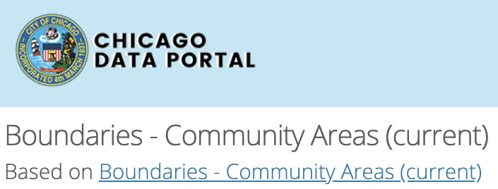
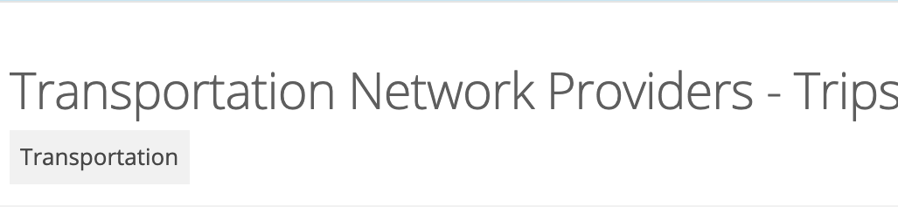
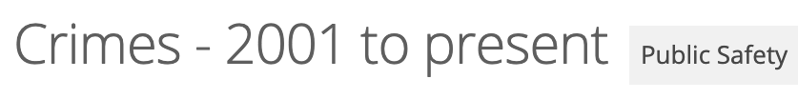
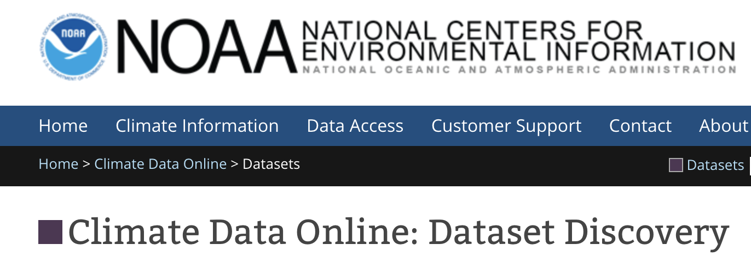
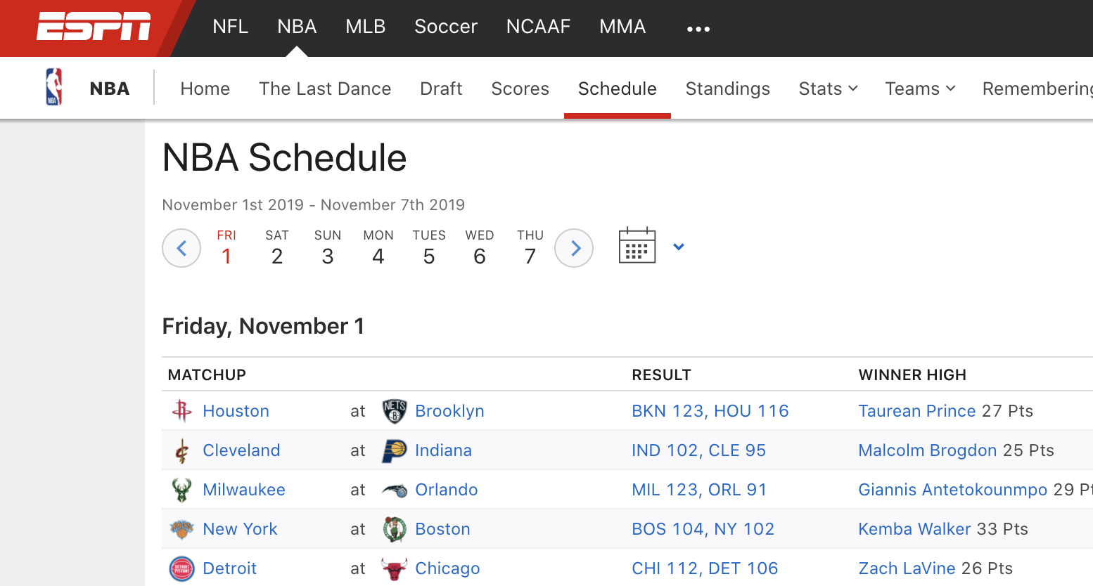
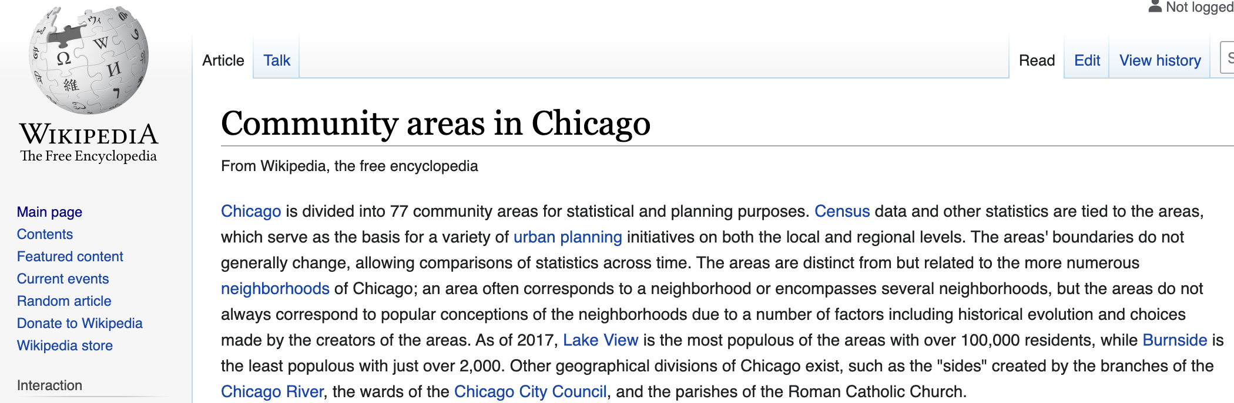
DATA PREPARATION
Structured Data:
◀︎ x GB/ x Rows
▼ x GB/ 129 Million Rows
Platform Considerations:
RCC is
Structured Data:
▲x GB/ 7.12 Million Rows
►x GB
▼x GB
Unstructured Data:
▼ From Web Scraping

Slide 6
DATA MODELING
Compiling Data into Tables
We use MySQLWorkbench to create our dimensional table. Sports and weather tables are based on Date (primary key), census and crime tables are based on CCA (primary key). Date and CCA both link to the fact table as foreign key.
Data Transformations
Date columns were originally text data type, and we transform the text data type to Date data type.
Matching Rules
We have one main dataset (fact table) and four supporting datasets (dim tables). Our rule is to link 4 supporting datasets to the main dataset with either DATE or CCA.
Number of Attributes
Tsa_cca_date: 7
Census: 12
Crime: 2
Weather: 4
Sports: 5

Slide 7
DESIGN CONSIDERATIONS
Data Types
id: INT
Date: DATE
CCA: INT
MEAN & MEDIAN attributes: DOUBLE
Others: INT
Dealing with NAs
Weather: Drop NA rows
Main Dataset: Fill NA with 0
Using Dimensional Tables
- Maintain historical information for any dimension
- Less processing time and higher performance
Expected Output of Data Analysis (Data Quality Metrics)
- The relationship between income level and ridership
- The impact of ridership on different weather
- The impact of ridership during major sports event
- The relationship between public safety and ridership

Slide 8
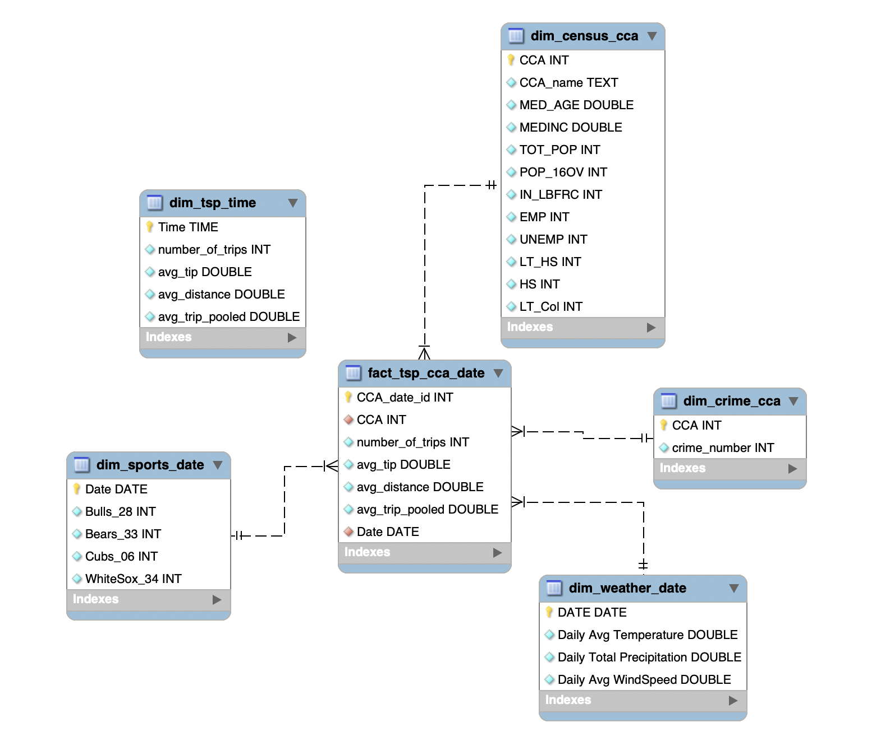
Enhanced Entity Relationship diagram

